Slide 1


Introduction to Environmental Model Building in Python
John Wainwright
BSG Training Course, Windsor
December 2025
https://github.com/john-wainwright/pythonAndModels

Slide 2
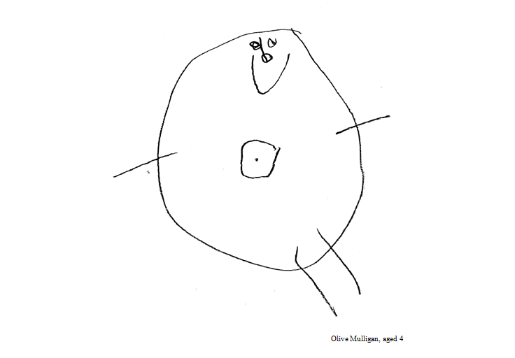

What is Modelling?

Slide 3

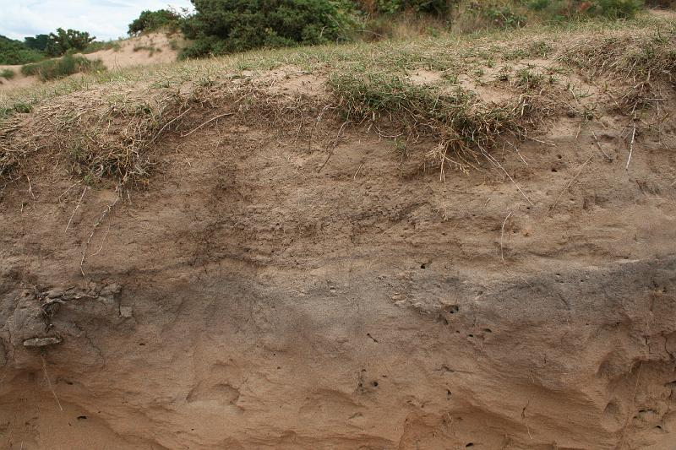
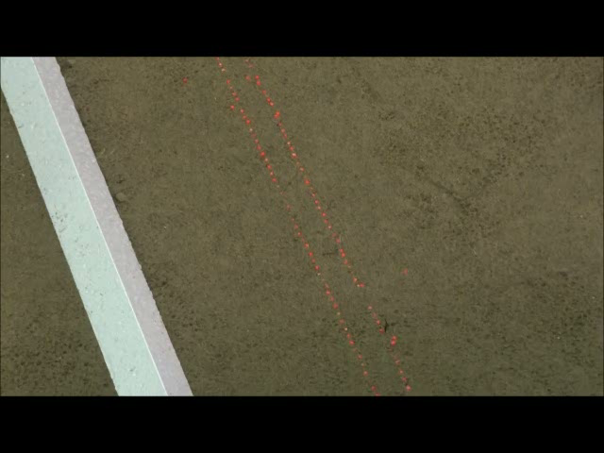


Building a Hydrological Model
Start with a 0D version
Soil simplified as a leaky bucket (with a leaky lid)
If the lid can’t let in enough water, Hortonian runoff (overland flow) occurs
As the bucket fills, it starts to drain sideways or downwards increasingly quickly
Once it’s full to the top, saturation overland flow occurs
Much simpler than solving the Richards equation!

Slide 4
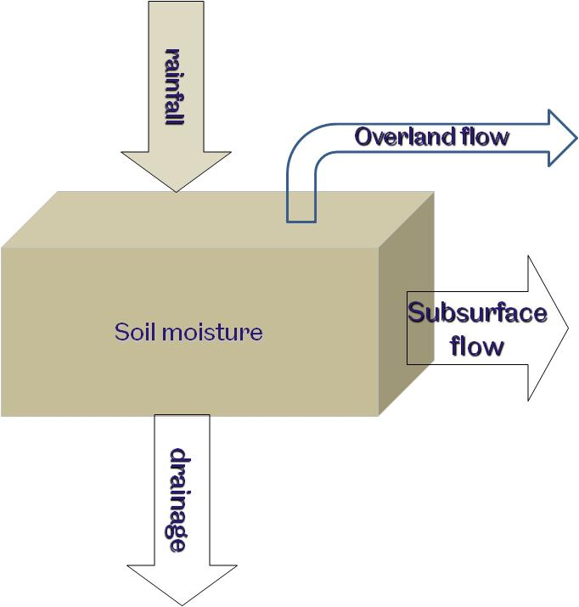

Conceptualizing the Leaky Bucket
Start with a store & flow diagram like this one
Write a balance equation:
θ is soil moisture [mm]
r is rainfall intensity [mm h⁻¹]
q_{of_up} is runon rate [mm h⁻¹]
q_{ssf_up} is upslope subsurface inflow [mm h⁻¹]
q_{of} is overland flow rate [mm h⁻¹]
q_{ssf} is subsurface outflow rate [mm h⁻¹]
q_{d} is drainage rate [mm h⁻¹]
Or as a finite difference equation:
Where k indexes the timestep
runon
$$\frac{dθ}{dt} = r+ q_{of_up} + q_{ssf_up} – q_{of} − q_{ssf} − q_{d}$$
Ssf inflow
$$θ_{k} = θ_{k − 1} + dt \left(r_{k}+ –q_{of_up k}{+{ q}_{ssf_up, k} − q}_{of, k} − q_{ssf, k} − q_{d, k} \right)$$

Slide 5

Conceptualizing the Leaky Bucket
Start with a store & flow diagram like this one
Write a balance equation:
θ is soil moisture [mm]
r is rainfall intensity [mm h⁻¹]
q_{of_up} is runon rate [mm h⁻¹]
q_{ssf_up} is upslope subsurface inflow [mm h⁻¹]
q_{of} is overland flow rate [mm h⁻¹]
q_{ssf} is subsurface outflow rate [mm h⁻¹]
q_{d} is drainage rate [mm h⁻¹]
Or as a finite difference equation:
Where k indexes the timestep
runon
$$\frac{dθ}{dt} = r+ q_{of_up} + q_{ssf_up} – q_{of} − q_{ssf} − q_{d}$$
Ssf inflow
$$θ_{k} = θ_{k − 1} + dt \left(r_{k}+ –q_{of_up k}{+{ q}_{ssf_up, k} − q}_{of, k} − q_{ssf, k} − q_{d, k} \right)$$

Slide 6

Conceptualizing the Leaky Bucket
Start with a store & flow diagram like this one
Write a balance equation:
θ is soil moisture [mm]
r is rainfall intensity [mm h⁻¹]
q_{of_up} is runon rate [mm h⁻¹]
q_{ssf_up} is upslope subsurface inflow [mm h⁻¹]
q_{of} is overland flow rate [mm h⁻¹]
q_{ssf} is subsurface outflow rate [mm h⁻¹]
q_{d} is drainage rate [mm h⁻¹]
Or as a finite difference equation:
Where k indexes the timestep
runon
$$\frac{dθ}{dt} = r+ q_{of_up} + q_{ssf_up} – q_{of} − q_{ssf} − q_{d}$$
Ssf inflow
$$θ_{k} = θ_{k − 1} + dt \left(r_{k}+ –q_{of_up k}{+{ q}_{ssf_up, k} − q}_{of, k} − q_{ssf, k} − q_{d, k} \right)$$

Slide 7
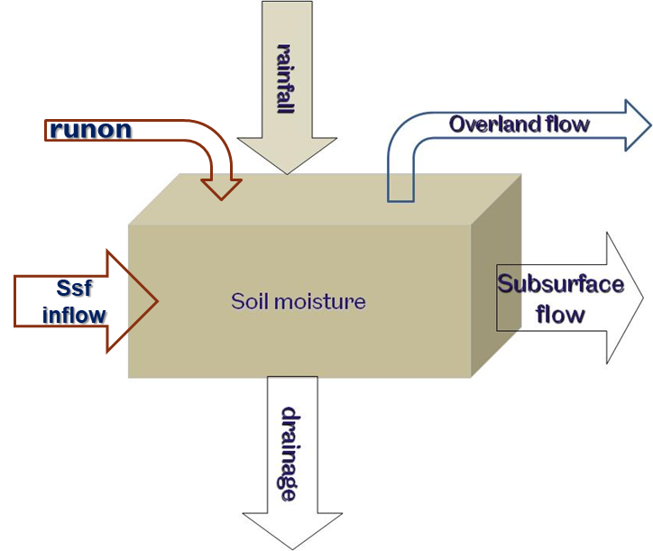
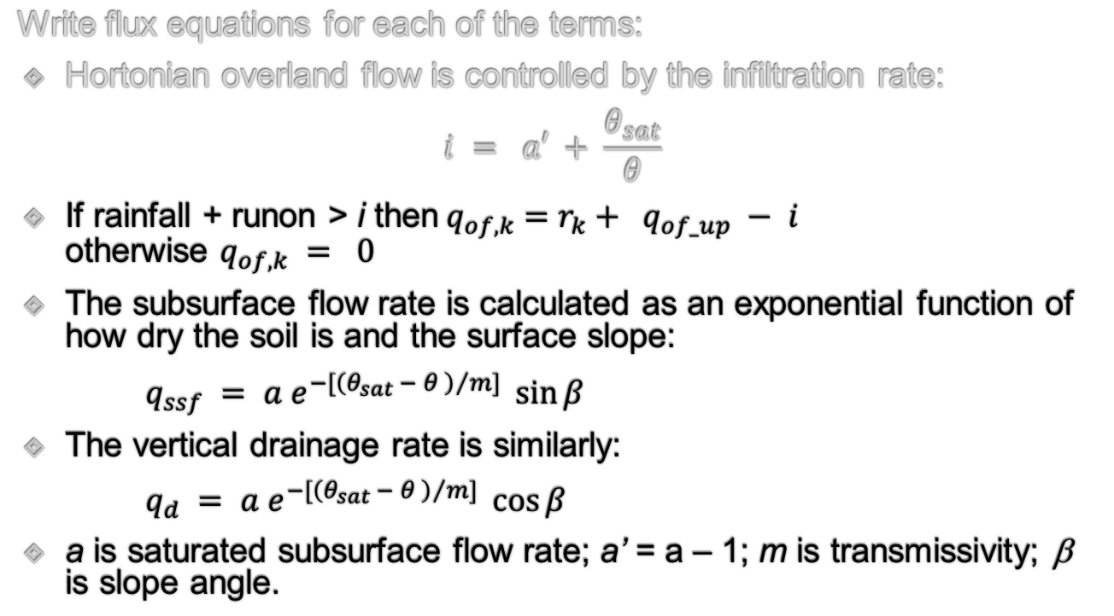
Conceptualizing the Leaky Bucket
Write flux equations for each of the terms:
Hortonian overland flow is controlled by the infiltration rate:
$$i = a′ + \frac{θ_{sat}}{θ}$$
If rainfall + runon > i then${ q}_{of,k} =r_{k}+ q_{of_up} − i$ otherwise $q_{of,k} = 0$
The subsurface flow rate is calculated as an exponential function of how dry the soil is and the surface slope:
$q_{ssf} = a e^{−\left[{\left(θ_{sat} − θ \right)}/m\right]}\sin{β}$
The vertical drainage rate is similarly:
$q_{d} = a e^{−\left[{\left(θ_{sat} − θ \right)}/m\right]}\cos{β}$
a is saturated subsurface flow rate; a’ = a – 1; m is transmissivity; β is slope angle.

Slide 8
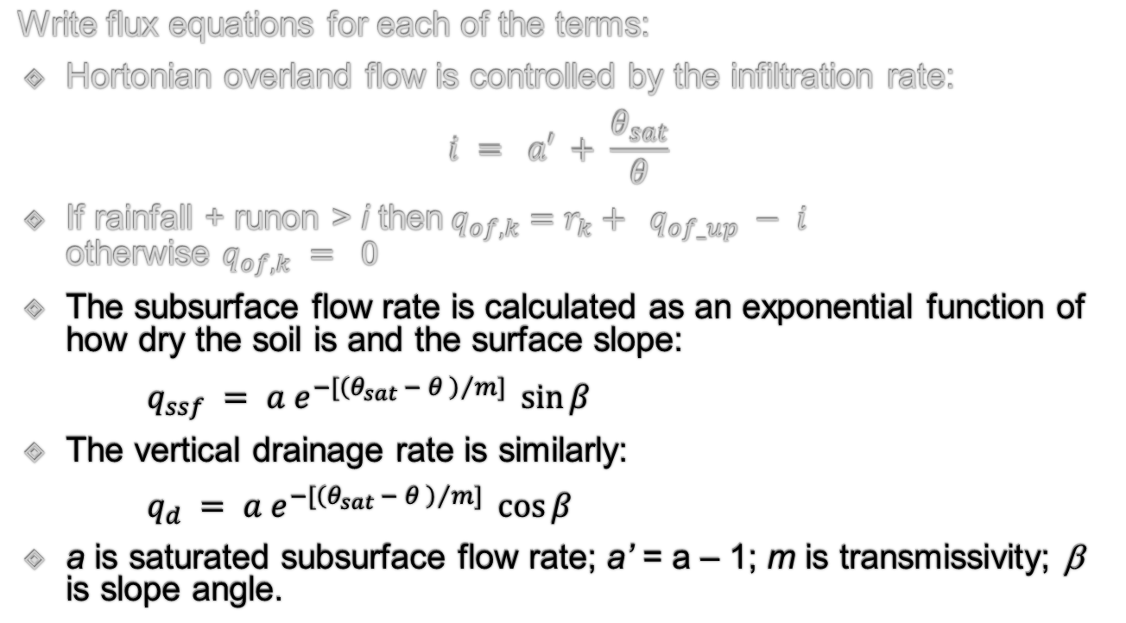
Conceptualizing the Leaky Bucket
Write flux equations for each of the terms:
Hortonian overland flow is controlled by the infiltration rate:
$$i = a′ + \frac{θ_{sat}}{θ}$$
If rainfall + runon > i then${ q}_{of,k} =r_{k}+ q_{of_up} − i$ otherwise $q_{of,k} = 0$
The subsurface flow rate is calculated as an exponential function of how dry the soil is and the surface slope:
$q_{ssf} = a e^{−\left[{\left(θ_{sat} − θ \right)}/m\right]}\sin{β}$
The vertical drainage rate is similarly:
$q_{d} = a e^{−\left[{\left(θ_{sat} − θ \right)}/m\right]}\cos{β}$
a is saturated subsurface flow rate; a’ = a – 1; m is transmissivity; β is slope angle.

Slide 9
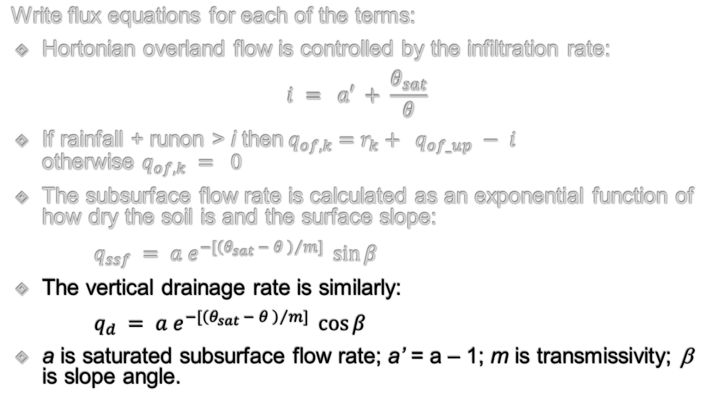
Conceptualizing the Leaky Bucket
Write flux equations for each of the terms:
Hortonian overland flow is controlled by the infiltration rate:
$$i = a′ + \frac{θ_{sat}}{θ}$$
If rainfall + runon > i then${ q}_{of,k} =r_{k}+ q_{of_up} − i$ otherwise $q_{of,k} = 0$
The subsurface flow rate is calculated as an exponential function of how dry the soil is and the surface slope:
$q_{ssf} = a e^{−\left[{\left(θ_{sat} − θ \right)}/m\right]}\sin{β}$
The vertical drainage rate is similarly:
$q_{d} = a e^{−\left[{\left(θ_{sat} − θ \right)}/m\right]}\cos{β}$
a is saturated subsurface flow rate; a’ = a – 1; m is transmissivity; β is slope angle.

Slide 10
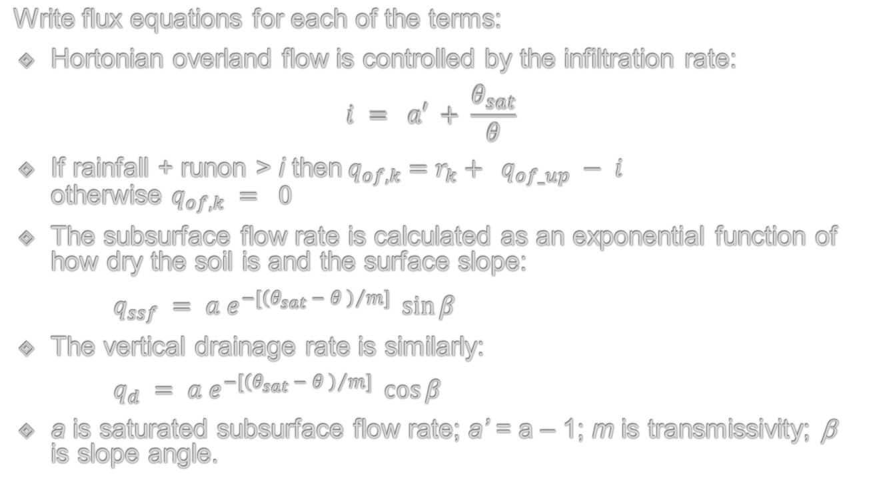
Conceptualizing the Leaky Bucket
Write flux equations for each of the terms:
Hortonian overland flow is controlled by the infiltration rate:
$$i = a′ + \frac{θ_{sat}}{θ}$$
If rainfall + runon > i then${ q}_{of,k} =r_{k}+ q_{of_up} − i$ otherwise $q_{of,k} = 0$
The subsurface flow rate is calculated as an exponential function of how dry the soil is and the surface slope:
$q_{ssf} = a e^{−\left[{\left(θ_{sat} − θ \right)}/m\right]}\sin{β}$
The vertical drainage rate is similarly:
$q_{d} = a e^{−\left[{\left(θ_{sat} − θ \right)}/m\right]}\cos{β}$
a is saturated subsurface flow rate; a’ = a – 1; m is transmissivity; β is slope angle.

Slide 11
Flowcharts
Start/Stop
Process
Input/Output
Decision
Flow of logic
A
Continuation

Slide 12
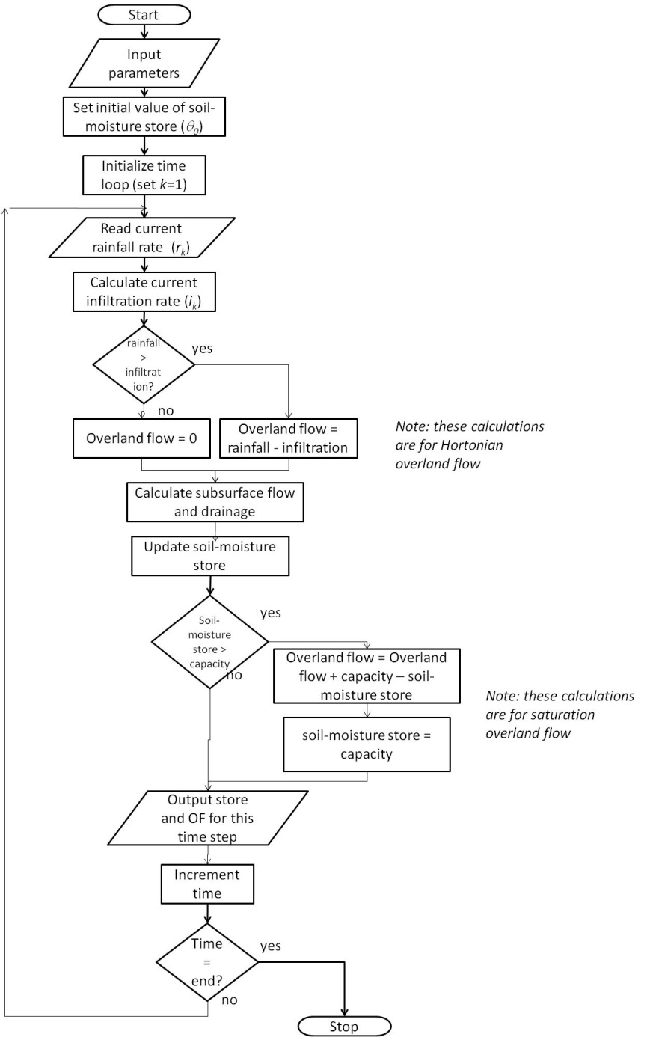
Define the Calculation Steps
Here’s an example of a flowchart describing the steps of the calculations we need
Note boundary conditions:
Either set inflow (runon and subsurface flow) as zero (e.g. top of hillslope)
Or define values
Initial value:
Need to specify the initial soil-moisture value

Slide 13
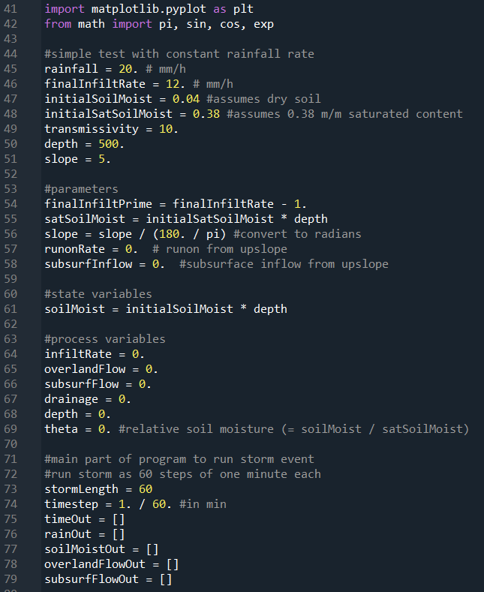
LeakyBucket0 code (1)
Import libraries – plotting and specific maths functions
Parameters for a specific run. Change these to represent different conditions
Initialize the model:
Parameters
State variable
Process variables
Set up conditions for a simple example storm and lists to output results

Slide 14
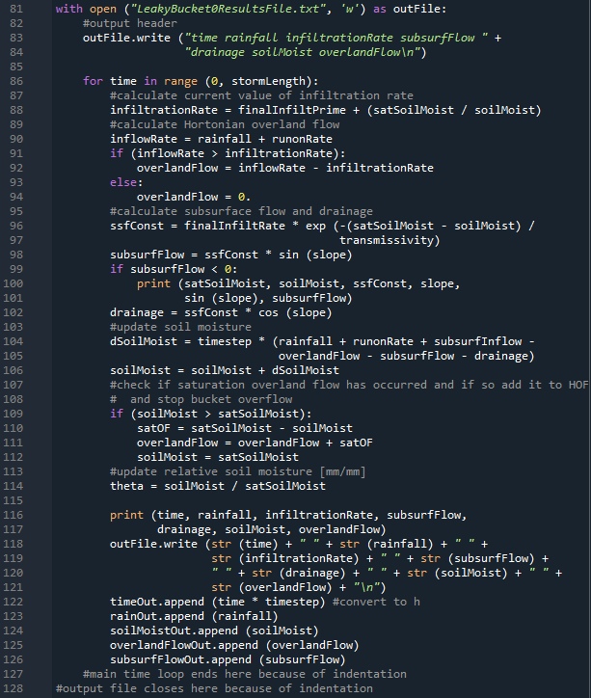
LeakyBucket0 code (2)
with loop for output file
Main loop for storm

Slide 15
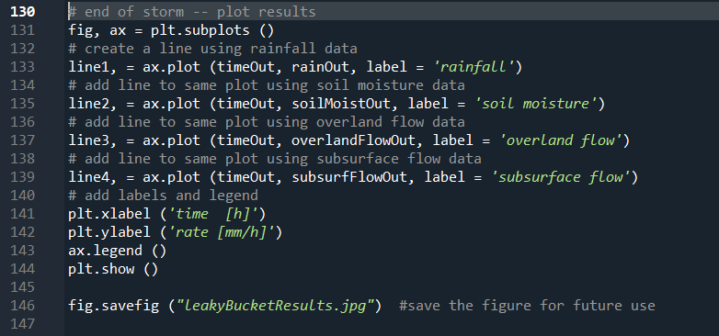
LeakyBucket0 code (3)
Plot figure at the end of the storm event
Save the plot as a jpg
Change some of the model parameters (rainfall, infiltration rate, transmissivity, soil depth). Do the results make sense?
Create a simulation where you have a length of rainfall followed by the same length of time with no rainfall.
A sensitivity analysis looks at the change of model output over a change of model inputs. How might you implement an analysis of the sensitivity to final infiltration rate over a given range of values?

Slide 16
Object-orientated programming OOP
If we’re trying to represent things, why not represent them as things?
In the procedural version of LeakyBucket, we have a list of commands and understanding how they relate to what we are trying to model is rather obtuse
In OOP, we create structures (called classes) where the information is kept relative to what we are trying to model, and on which we define ways of modifying the characteristics of the structure (called methods).

Slide 17
Reasons for OOP
Modularity
Reuse of code
Easier to debug (?)
Easier to update
Faster to develop (once you’ve got the hang of it)

Slide 18
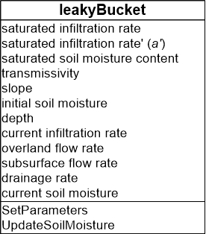
Making a Leaky Bucket Class
Name of class
Attributes of class
Methods of class
The attributes are the variables associated with the class. This idea is called encapsulation
The methods are the functions we apply to the attributes or allow the class to communicate with the outside world

Slide 19
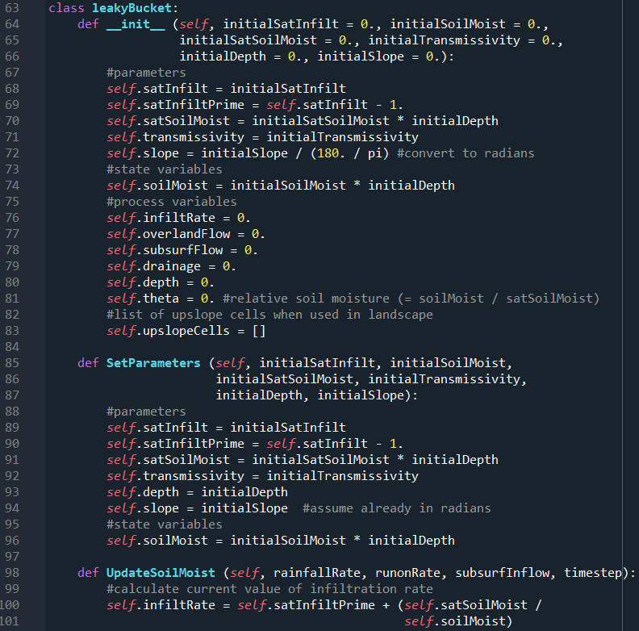
Defining a Class in Python
Name of class
Attributes of class
Methods of class
def __init__ (self, …): is a special function we need to call to initialize the class when we set it up (the lines are double underscores before and after the word init)
Note the use of self in the call and the variable name. It means that these variables refer to the specific instance of the class when it is set up
The methods SetParameters and UpdateSoilMoisture are also set up as a function and must include the reference to self
ssfConst in the UpdateSoilMoisture method is a local variable. Because of its scope, we can’t see it outside this method.

Slide 20
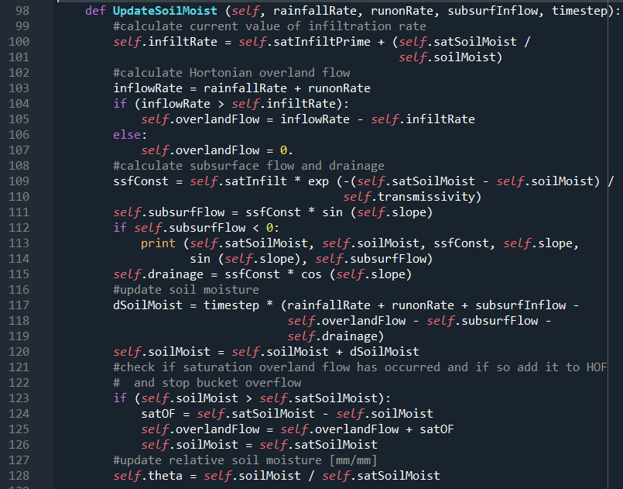
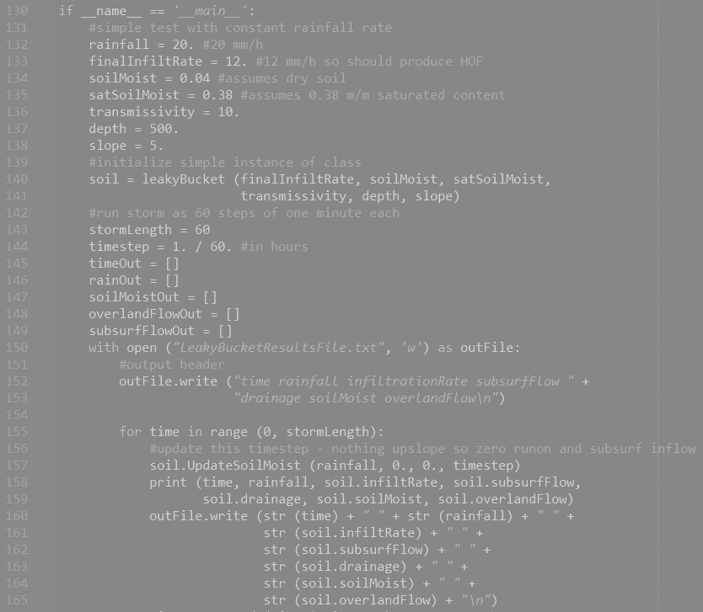
leakyBucket.py
UpdateSoilMoist method
Implementation of 0D model

Slide 21
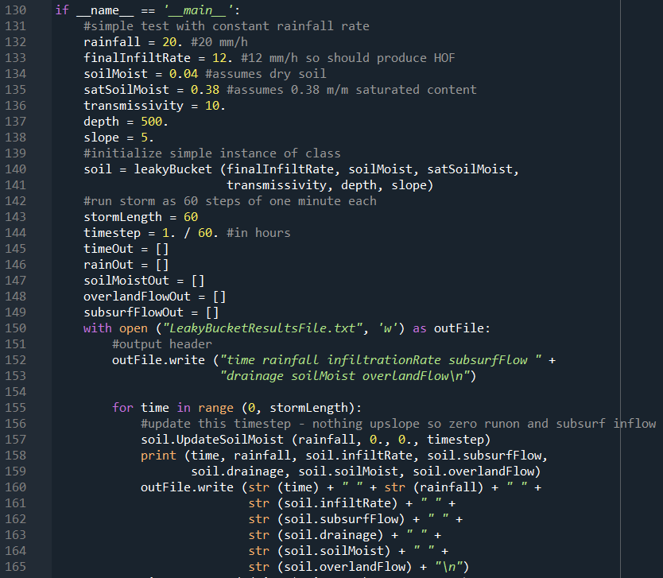
leakyBucket.py
UpdateSoilMoist method
Implementation of 0D model

Slide 22
Program control
But what on Earth does:
if __name__ == ‘__main__’ : do??
Note again the double underscores before and after each word.
__name__ is a system variable created when Python loads in the file. If the file is loaded like this one, it is given the name ‘__main__’, to show it is the main code to be run. We’ll see later that we can import code to reuse it. When this happens, __name__ is given the filename, so this bit of code would not be run (because __name__ != ‘__main__’)
Always == for a comparison (= for assignment)
!= is not equal to

Slide 23
Spatializing the model
We need to know how different components of the model link together:
Overland flow from upslope becomes runon at the next point downslope
Subsurface flow from upslope becomes subsurface inflow at the next point downslope

Slide 24
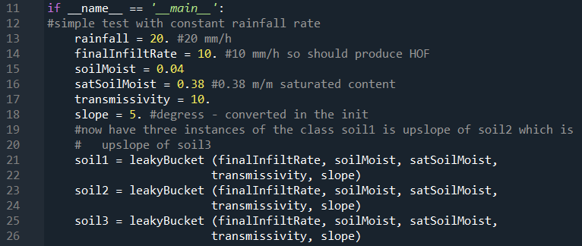
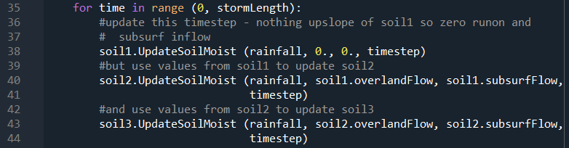
Building a 1D Hillslope from leakyBuckets
simpleHillslope-1.py
Initialize as three instances soil1, soil2, soil3 of the leakyBucket class →
In the main loop we need to link the different stores explicitly
This is fine for three leakyBuckets, but could get tiresome for long slopes!

Slide 25
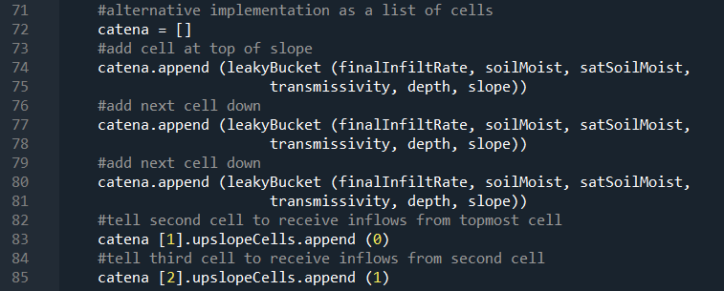
Lists in Python: another 1D Hillslope of leakyBuckets
simpleHillslope-2.py (note the first part of the code duplicates simpleHillslope-1.py so we can test the two versions)
Here we set up a “catena” of leakyBuckets using a list
In Python a list can be made up of any sort of object, including classes, which makes them very flexible
catena [] sets up an empty list
catena.append (leakyBucket (…)) adds an instance of the leakyBucket class to the list (so we do this three times for each of the stores)
I’ve added a list of upslope cells to the leakyBucket class so we can tell the class where the inflow come from so catena [1].upslopeCells.append (0) tells instance 1 that instance 0 is upslope of it. (Note the flexibility of a class in what it contains.)

Slide 26
Outputting Results
leakyBucket.py shows how to output the results to a file. Use this method to output the results from simpleHillslope-2.py to file, outputting the soil moisture and runoff values for each of the stores
Read these values into R and create a plot of the outputs
(if you feel more confident in Python, create a new script to read the data back in. If you’re an export, see if you can do it using pandas and seaborn.)

Slide 27
Extending the list approach
Write a version called simpleHillslope-3.py that has 50 leakyBucket stores along the catena
Generalize it to have any number of leakyBucket stores

Slide 28
Final thoughts
You’ve all been doing modelling for a long time!!
Start simple and build up the complexity (think Ockham)
… or Keep It Simple (and) Stupid!
Building a numerical model forces you to conceptualize what you (think you) know about your system
It allows you to think about what you might need to measure in the field or lab (either for model inputs or for data to test the model)
It allows you to test whether the conceptualization of the model is consistent with observations (but remember that either your model or your data [which are models] or both could be wrong!)
Developing general skills for organization and logic

Slide 29
Python basics (A very short reference)

Slide 30
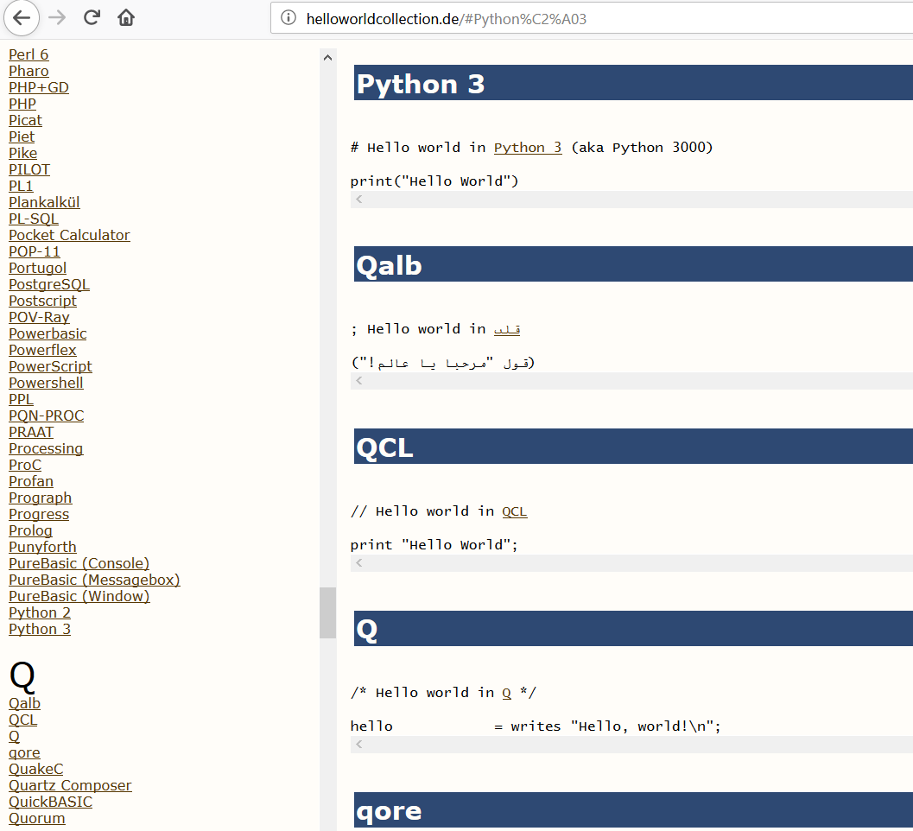
HelloWorld
print (‘Hello World’)
Also use for simple maths:
print (2 + 2)
In the console, you can type:
2 + 2

Slide 31
Some Python Basics
Assign a value to a variable:
a = 1
Assign values to a list:
b = [1., 2, 5., 7., 1.5e2]
Note Python sets the type of the variable on the fly, and that a list can have mixed types as in this example
To reference elements of a list use square brackets. The first element is always referenced as zero:
b [0]
Or you can return a series of values (called slicing):
b [0:2]
A slice goes to the last but one of the upper limit (check what the above expression does). Negative numbers count back from the end of the list. Try the following three:
b [-1]
b [2: -1]
b [2: ]

Slide 32
Some (more) Python Basics
Set up a list with lots of identical values:
i = [0] * 1000
Set up a 2D list:
j = [[1, 2, 3, 4], [5, 6, 7, 8], [9, 8, 7, 6]]
And reference values from it:
j [2][3]
Note that a 2D list in Python doesn’t have to be rectangular
We can define 3D lists but depending on the purpose there may be better ways of achieving our purpose! (See NumPy later.)
It’s also possible to set up an empty list and add things to it later:
k = []
k.append (2)

Slide 33
Controlling Program Flow
Often we want to loop through a set of commands multiple times. There are two main types of loop, (1) the for loop:
for i in range (0, 10):
<commands to be carried out>
Note that range (start, stop [, step]) is an object that allows variable i to iterate through its values. Try the above with print (i) in the loop to see what happens.
And (2) the while loop:
while <condition is True>:
<commands to be carried out>

Slide 34
More Control
You might see a variant of the while loop:
while True:
<commands to be carried out>
if condition == True:
break
Which will always carry out the loop once (the first form may never carry out the loop). Be careful with this second type not to get stuck in the loop infinitely, which is tiresome.
The break keyword jumps out of the current while loop or can be used to jump out of the current for loop

Slide 35
Conditions
We’ve just seen:
if condition == True:
<commands to be carried out>
It’s also possible to use:
if condition == True:
<commands to be carried out>
else:
<commands to be carried out>
And
if condition == True:
<commands to be carried out>
elif <condition == True>:
<commands to be carried out>
else:
<commands to be carried out>
(I think “elif” breaks the Python philosophy about code readability, but there you go!)

Slide 36
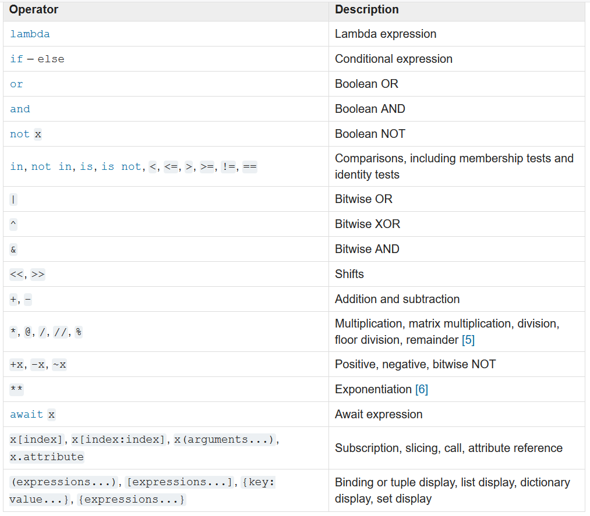
((Precedence) or (why parentheses are important))
Lowest (carried out last)
Highest (carried out first)
https://docs.python.org/3/reference/expressions.html

Slide 37
Further References
There are LOTS of Python resources out there – both to find out how to do something and what to do if something’s gone wrong. Always look first on your favourite search engine!
Some useful resources for your next steps:
https://automatetheboringstuff.com/ by Al Sweigert
https://greenteapress.com/wp/ books on coding, data analysis and modelling in Python (and more) by Allen Downey
Python Package Index: http://pypi.org/
Cheat sheets (https://pandas.pydata.org/Pandas_Cheat_Sheet.pdf copied on the next slides for pandas)
(But there’s a huge amount of stuff out there so search for specific topics.)

Slide 38
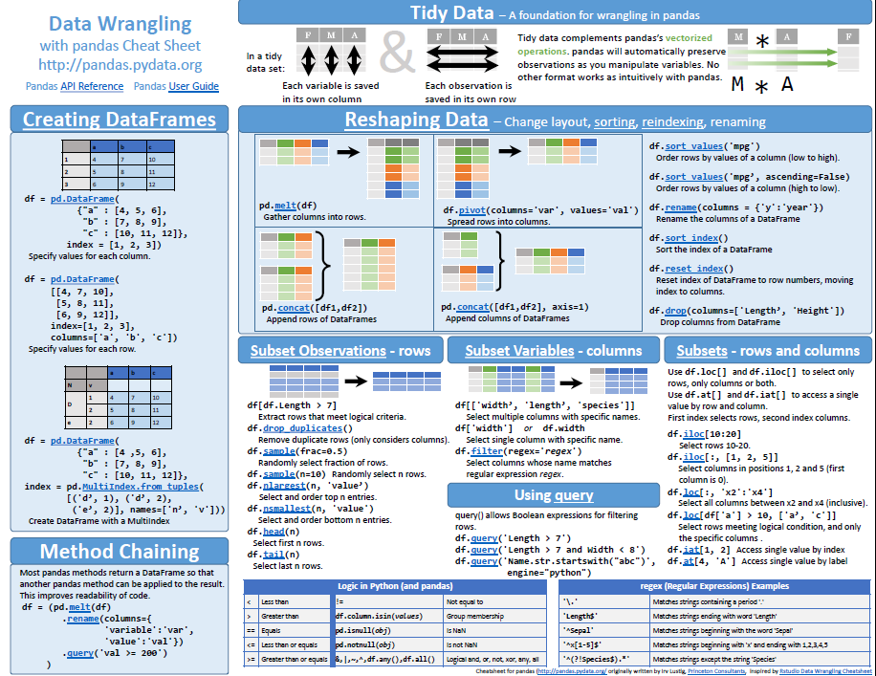

Slide 39
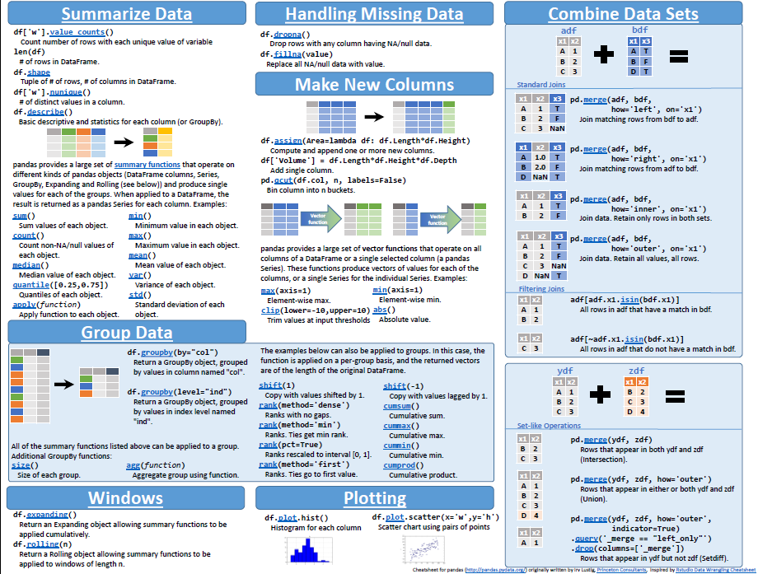

Slide 40
Using an IDE

Slide 41
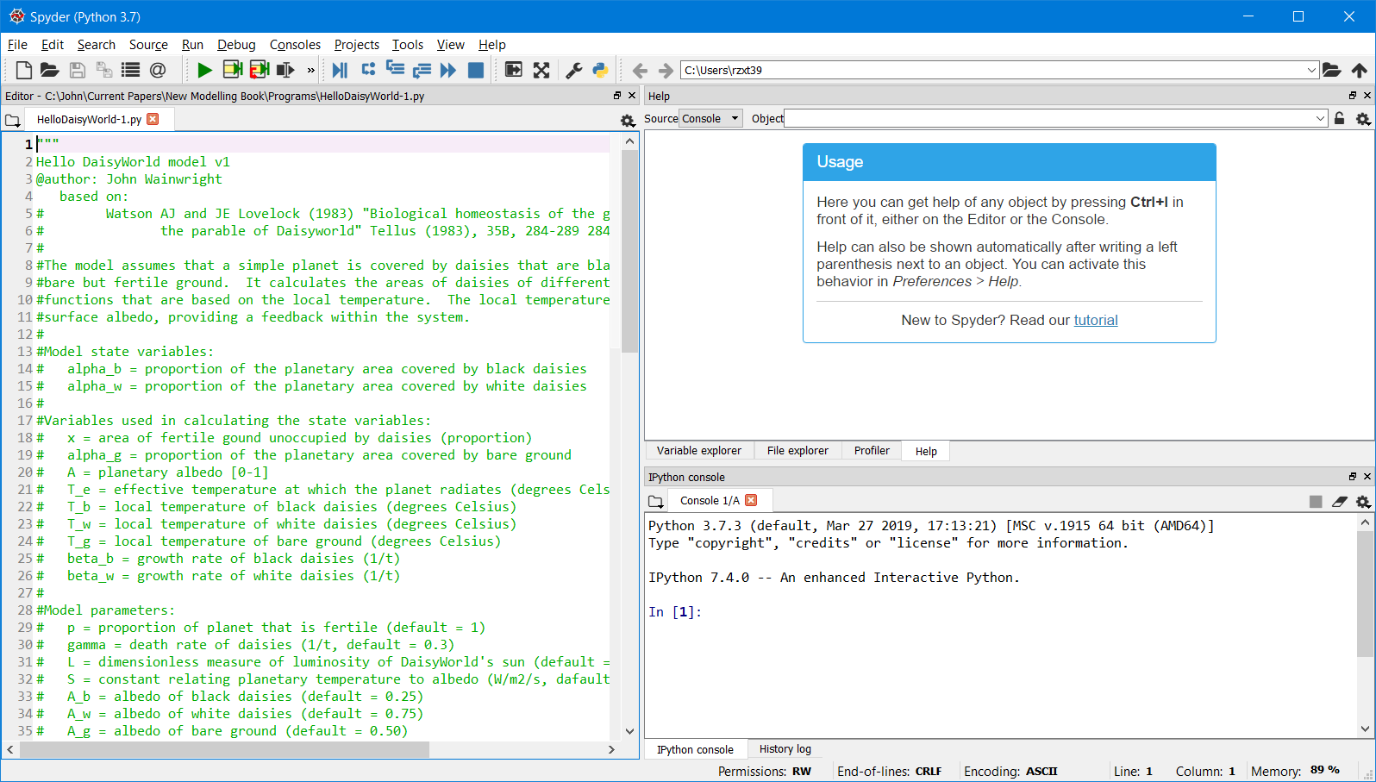
Using an IDE (Spyder)
Run code
Help window
Code window
Other tabs select variables, files or profiler
Console

Slide 42
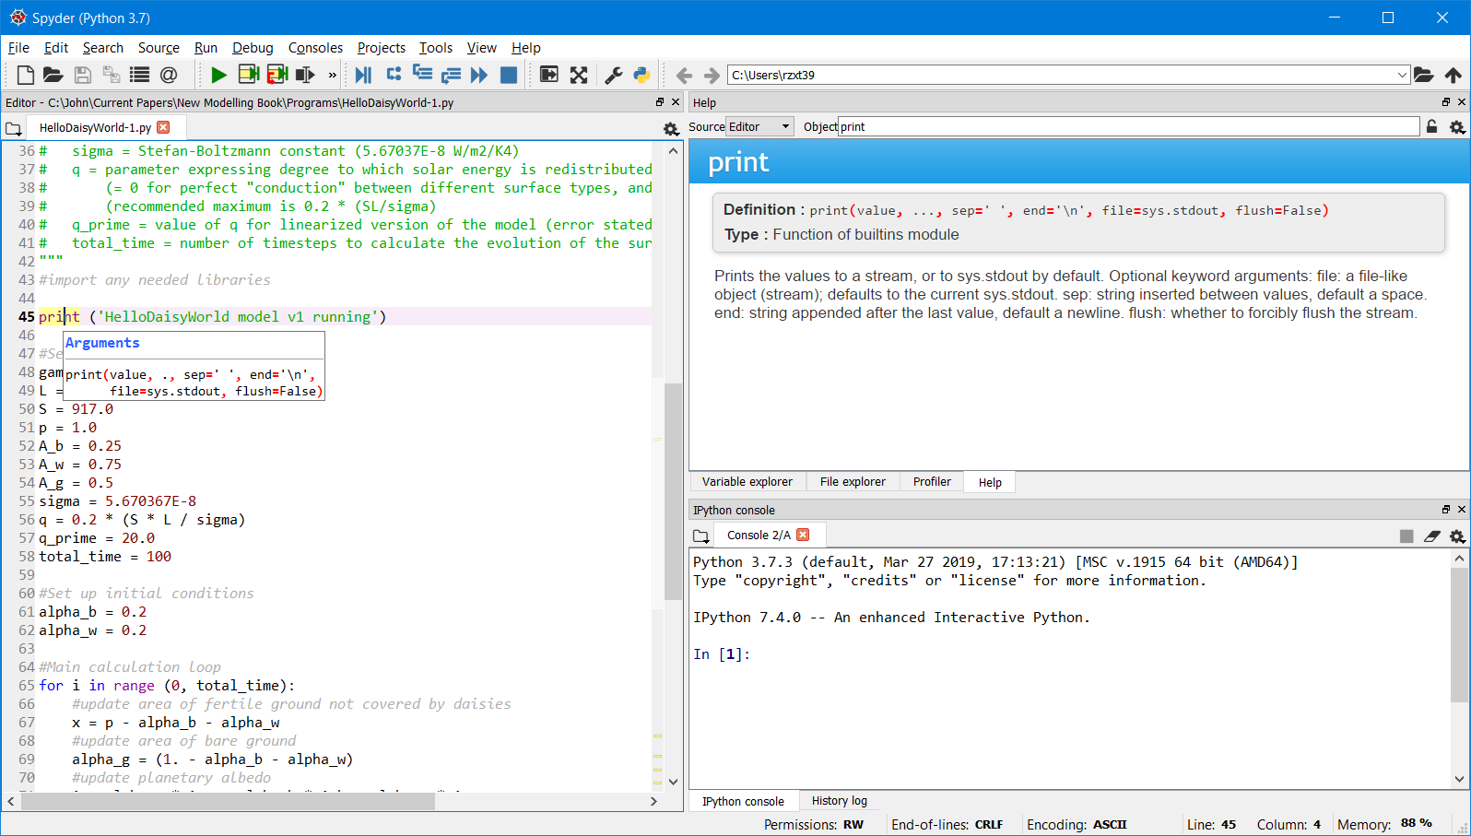
Help!
Ctrl-I over a keyword in the program brings up help in the code and help windows

